Slide 1
River Pollution Monitoring System ---- AquaSense
John WU
Tommy XIN
Felix FAN

Slide 2
0. Content
01
Motivation
02
Current vs AquaSense
03
System Description
04
Validation
05
Conclusion

Slide 3
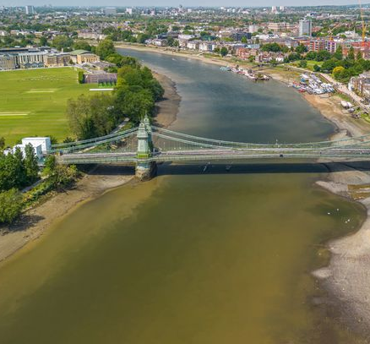
1. Motivation
River Pollution in London
River test samples:
92% samples -> coliform bacteria; 1% samples -> low dissolved oxygen [2].
Impact of Coliform on Residents:
Cause intestinal infection, vomiting, etc [3].
Our Objectives:
Real-time detecting;
Locating contamination
Fig. 1. Levels of E.coli were found around Hammersmith Bridge in west London [1]

Slide 4
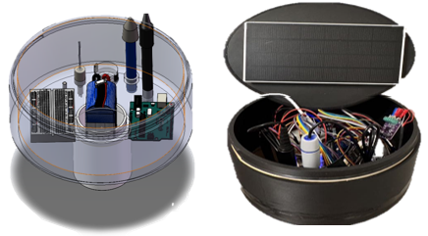
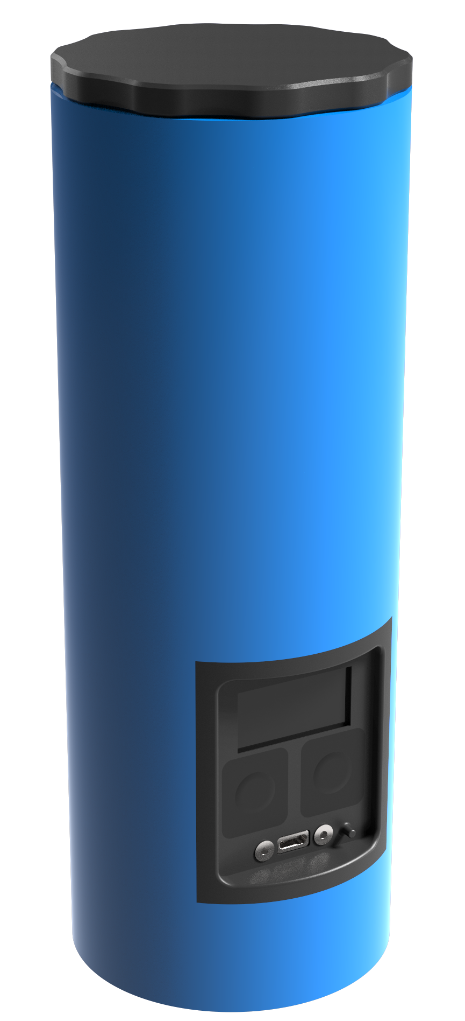
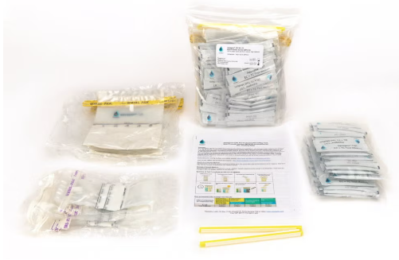
2. Current vs AquaSense
Brands | AquaSense | Fluidion ALERT One | ColiMinder | Aquagenx CBT EC+TC Kit
Detection Method | Inorganic sensor + AI model | Automated microbiological analysis | Enzymatic reaction (online) | Colorimetric biochemical reaction
Targets | E. coli + inorganic | E. coli + total coliforms | E. coli, total bacteria | E. coli + coliforms
Response Time | Real-time (seconds) | 2–3 hours | 15–30 minutes | 20–48 hours
Portability | Handheld | Handheld | Station-based | Portable kit
Automation Level | Fully automated | Semi-automated | Fully automated | Manual operation
Estimated Cost | £100–£200 per station | £1,000–£5,000 | £10,000+ | £5–£15 per test
Data Access | Platform + API | WiFi & App | Cloud access | Not supported
Unique Advantages | reagent-free, real-time alerts | ISO-compliant compact form | High accuracy, industrial use | Ultra-low-cost, field-usable
Fig. 2. AquaSense
Fig. 3. ALERT One[4]
Fig. 4. Aquagenx Kit

Slide 5
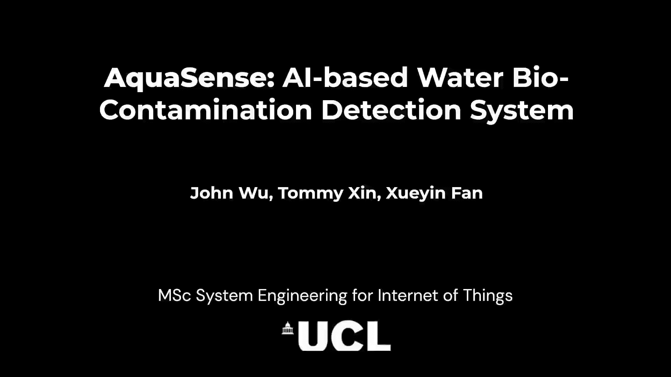
3. System Description – Overview

Slide 6
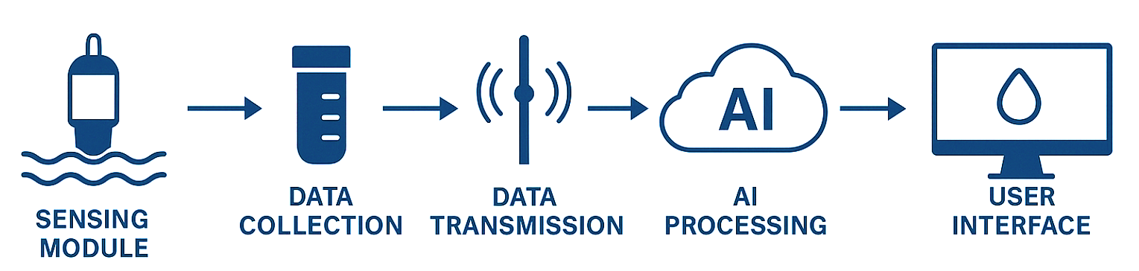
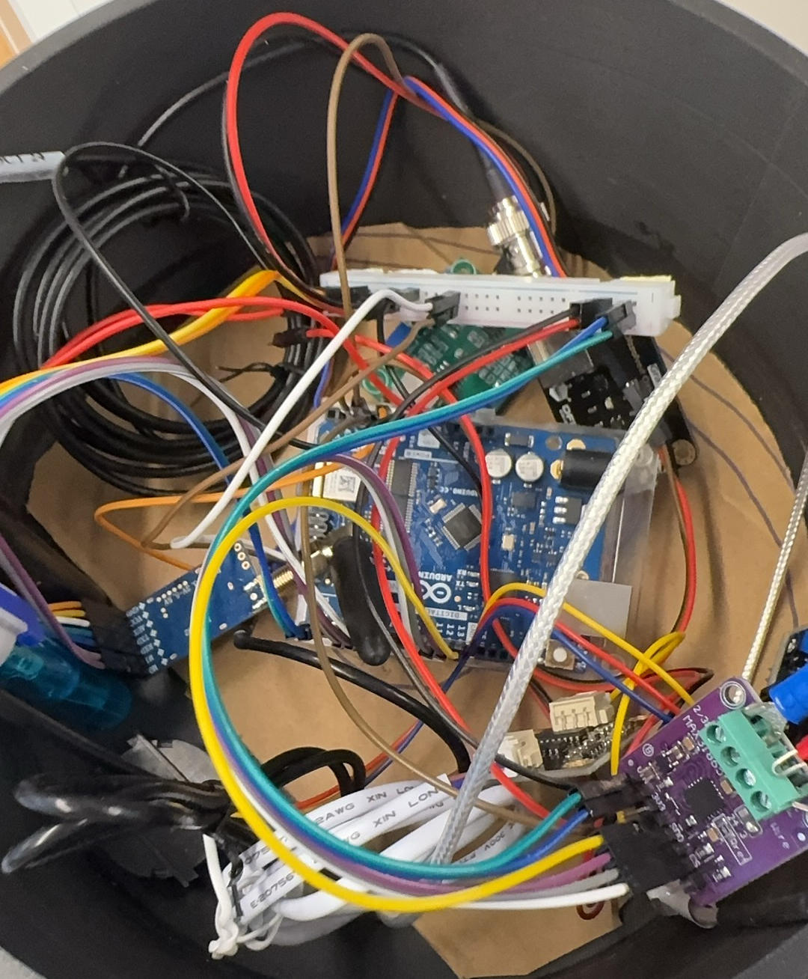
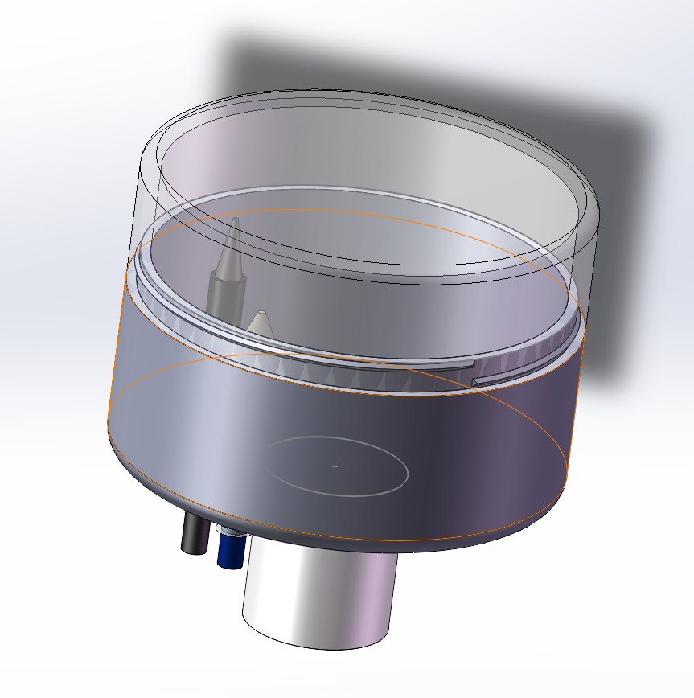
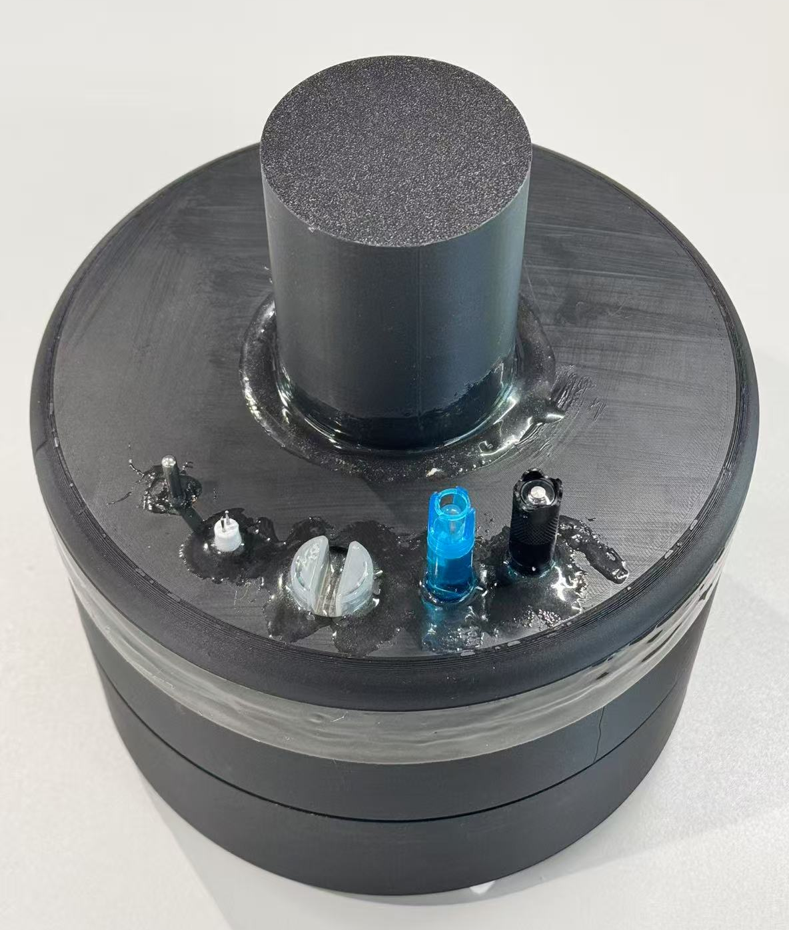
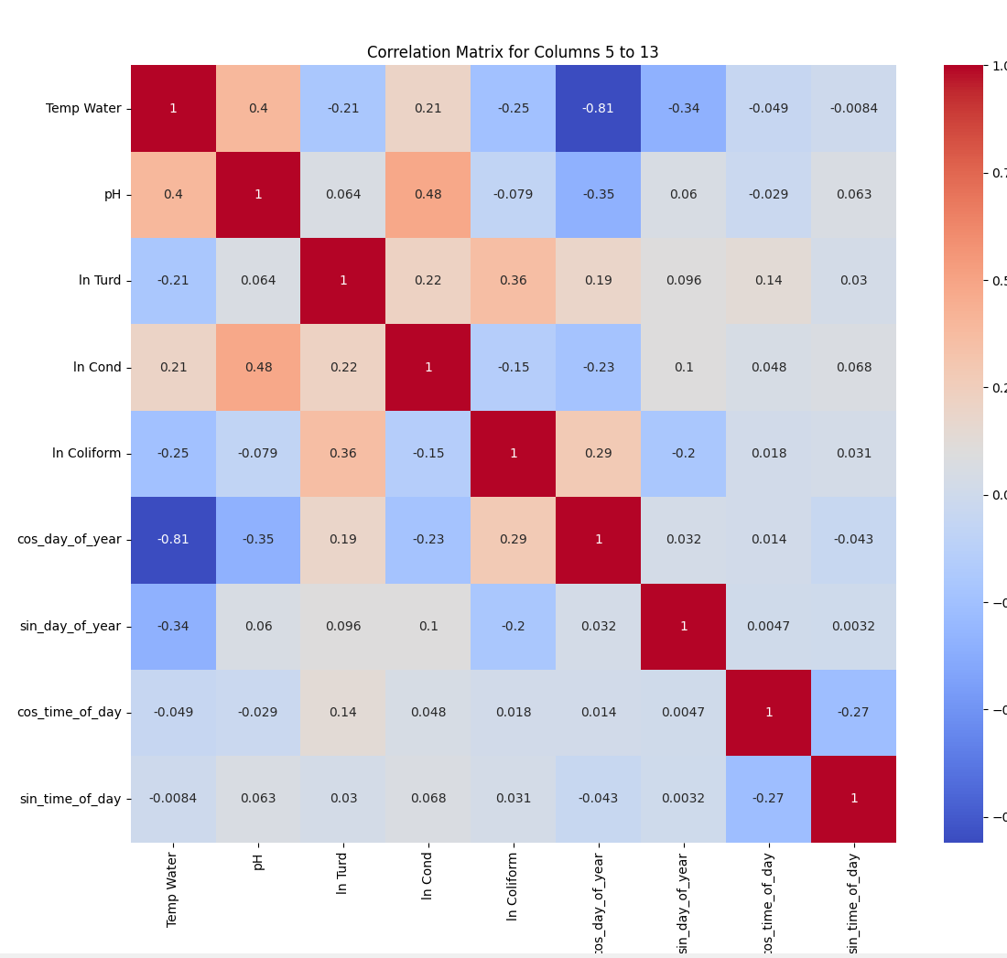
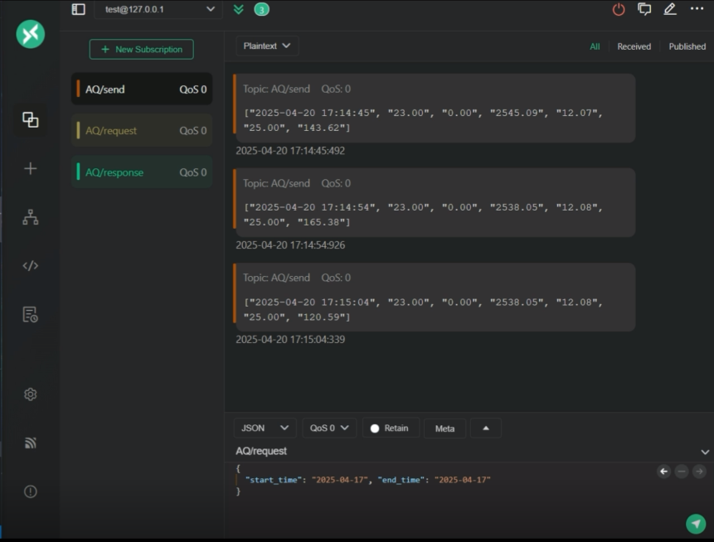
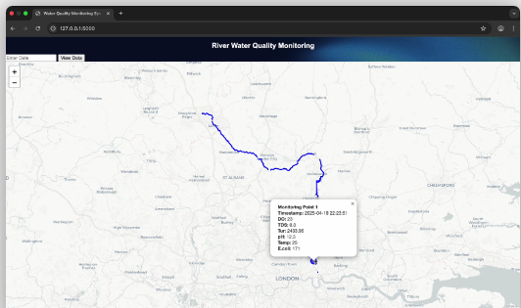
3. System Description – Overview
Fig. 5. Flow chart of AquaSense
Circuit Design
3D Design
Model Assemble
ML Data Process
Service End
Back-Front End
Fig. 6. Overview of AquaSense

Slide 7
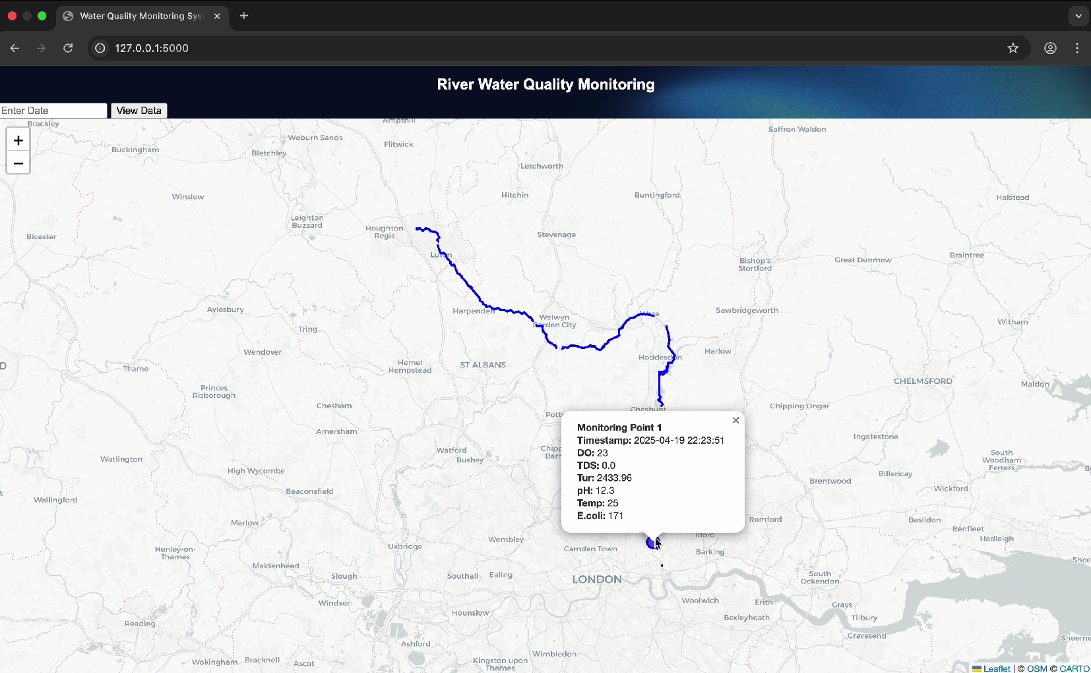
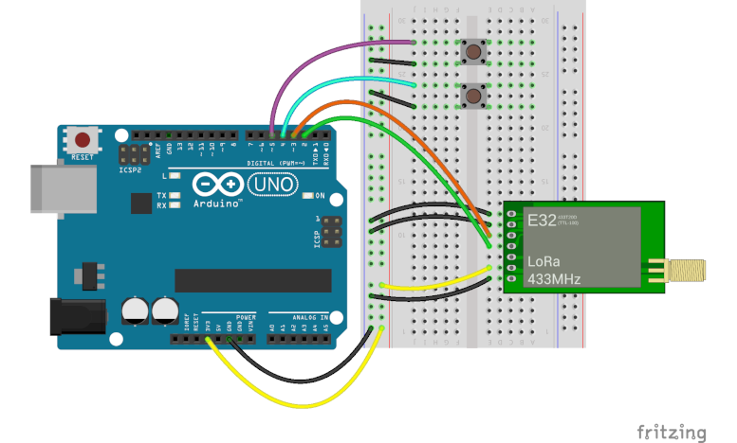
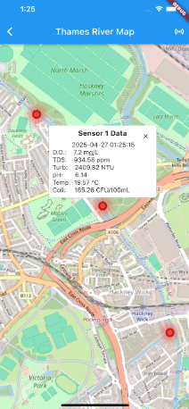
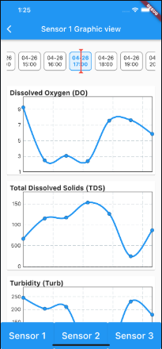
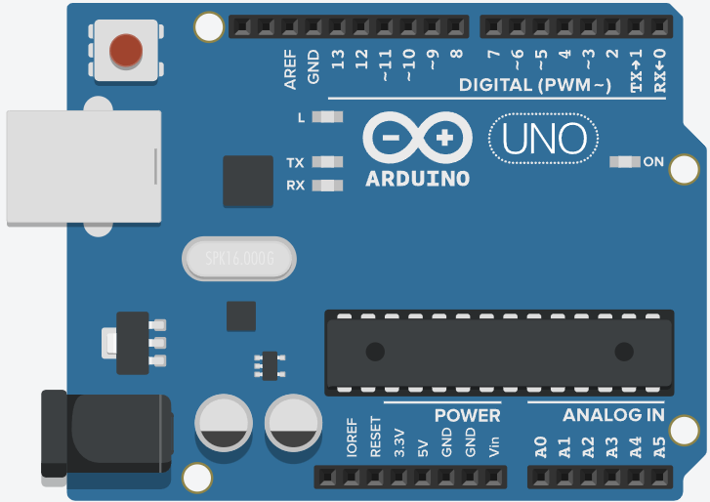

3. System Description – Embedded System
pH sensor
SCC
Analog Signal
MQTT transmission
Power Supply
LORA transmission
TTL Connection
Turbidity sensor
SCC
Webpage
TDS sensor
SCC
Arduino UNO
EC sensor
SCC
Arduino with sensors
Terminal equipment
DO sensor
SCC
RTC
LORA
Mobile App
Fig. 7. Schematic of Data Transmission
Multi-sensor integrated + LoRa transmission + Power-saving

Slide 8
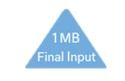
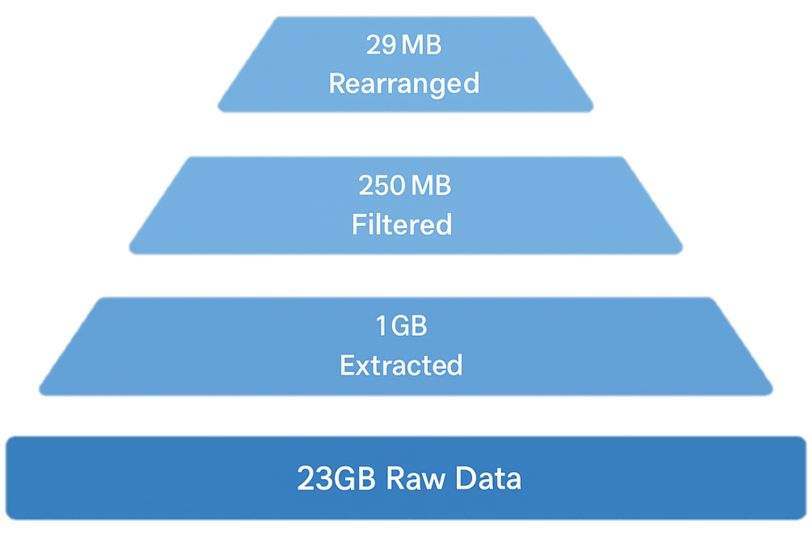
3. System Description – Data Processing
Clustered for distributional similarity; ready for AI modeling.
Unified units, applied long-tail log transform, removed outliers.
Retained measurements with same time and location for contextual relevance.
LLM-assisted filtering of entries mentioning Coliform or E. coli.
Historical water sensor data (2000–2025) from across the UK.
Fig. 9. Data Processing procedures

Slide 9
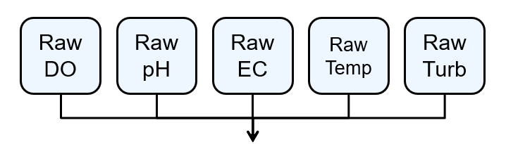
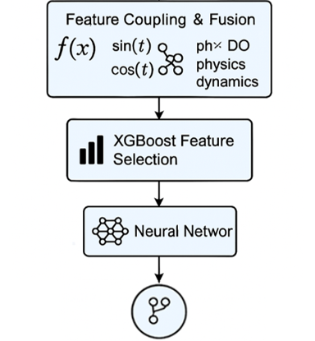
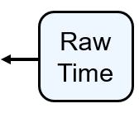

3. System Description – AI Model
DO: Dissolved Oxygen
EC: Electric Conductivity
Temp: Temperature
Turb: Turbidity
n/(n+1)
sin(t), cos(t)
Temp * Turb
…
1st: Cond n/(n+1)
2nd: Cond * F(t)
3rd: Turb * Cond
…
StandardScaler
leaky_relu+HuberLoss
L2+Droupout
EarlyStop
Neural Network
E. Coli Concentration output
Fig. 10. Machine Learning Model

Slide 10
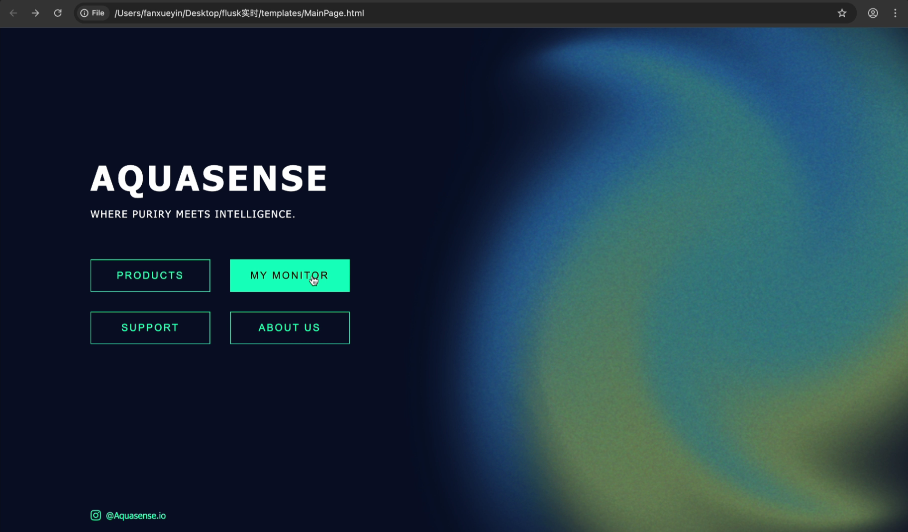
3. System Description – Data Flow
Fig. 5. Flow chart of AquaSense

Slide 11
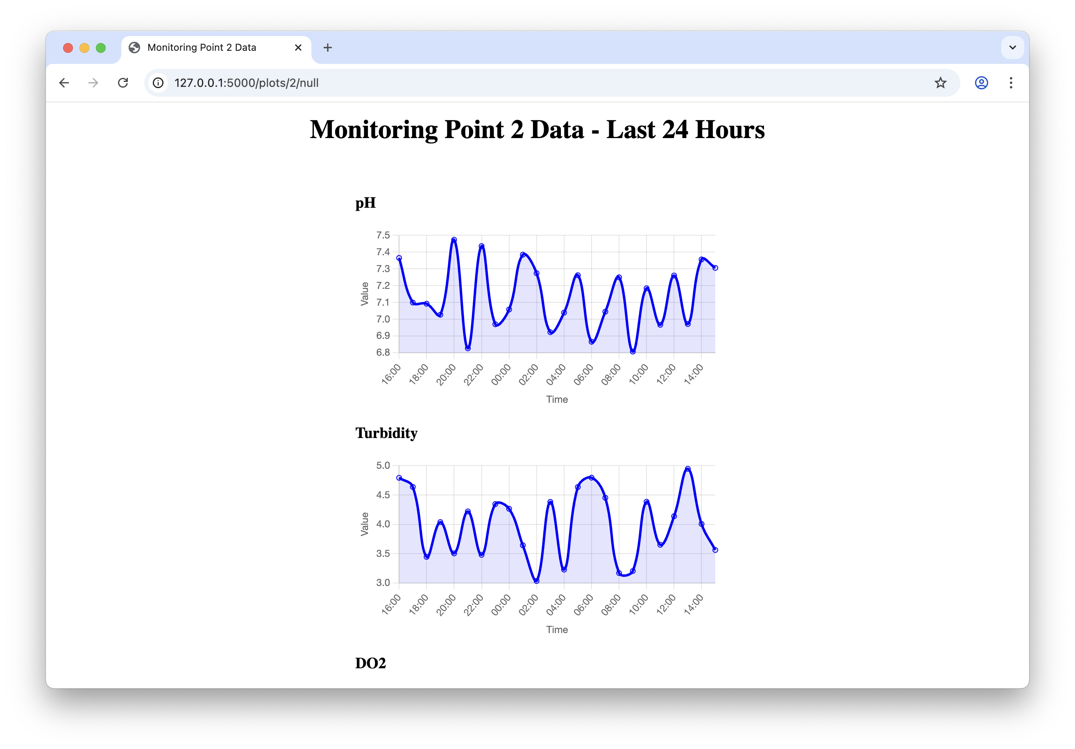
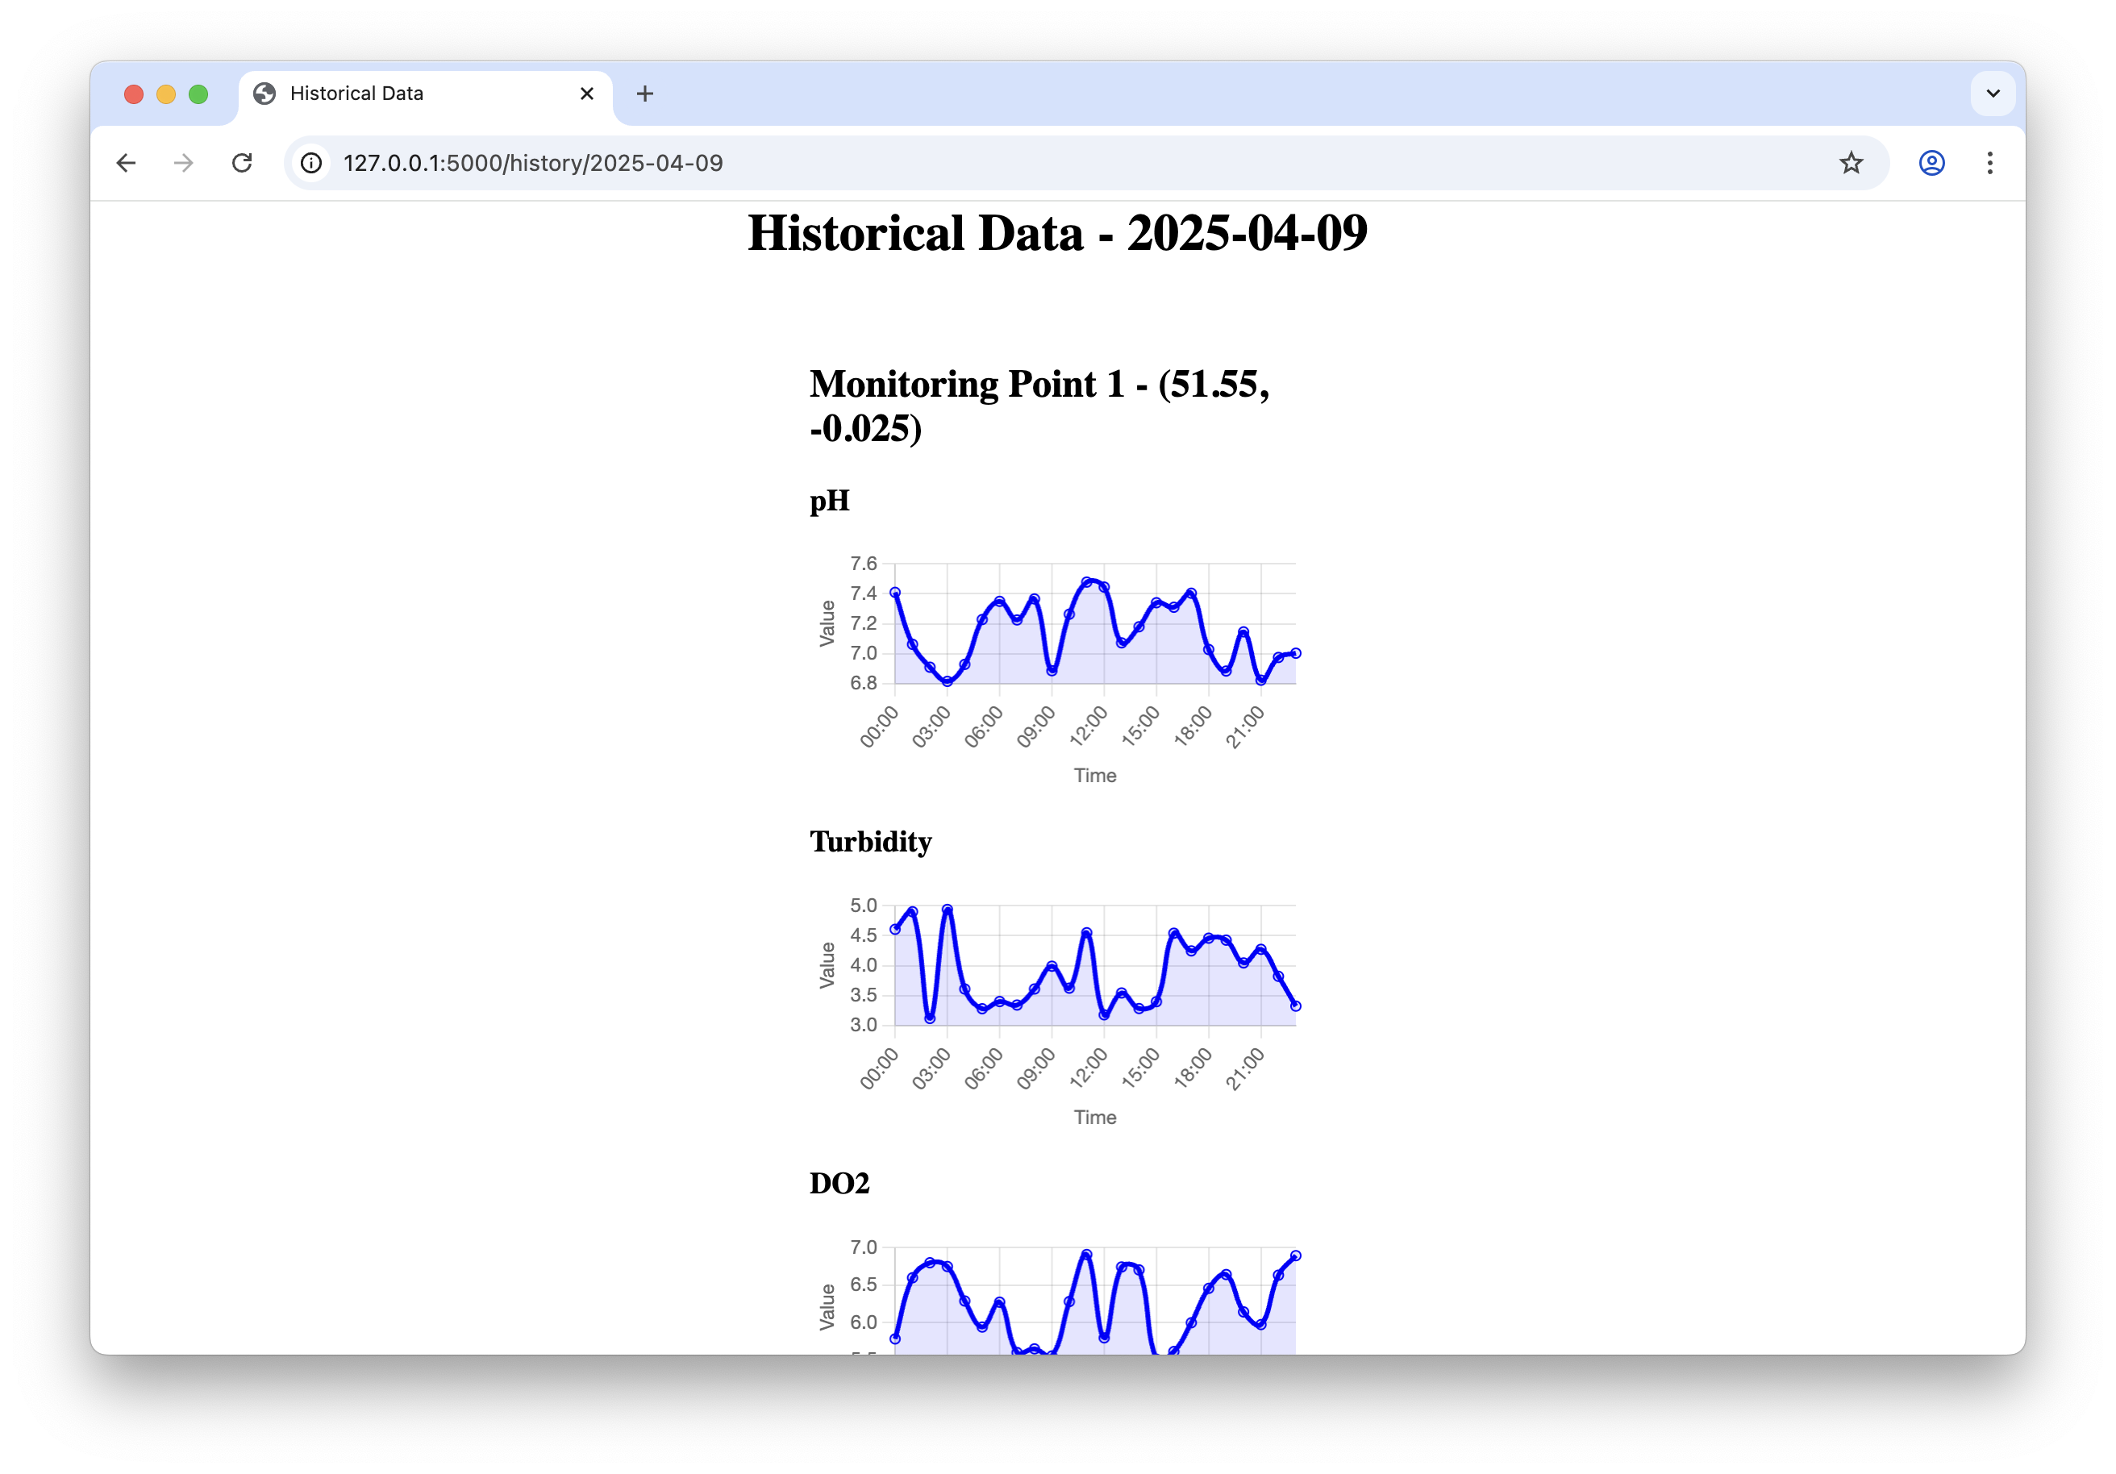
3. System Description – Dashboard
Details
Fig. 11. Visualized Dashboard
MQTT → Flask → JSON

Slide 12
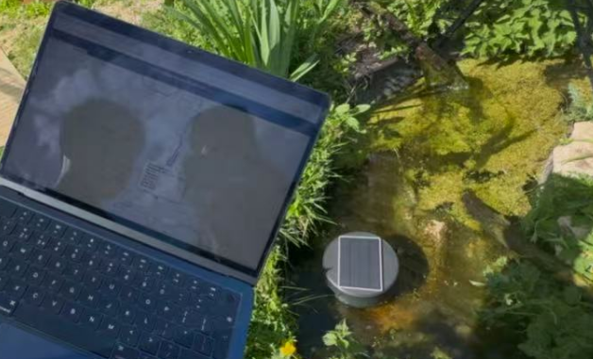
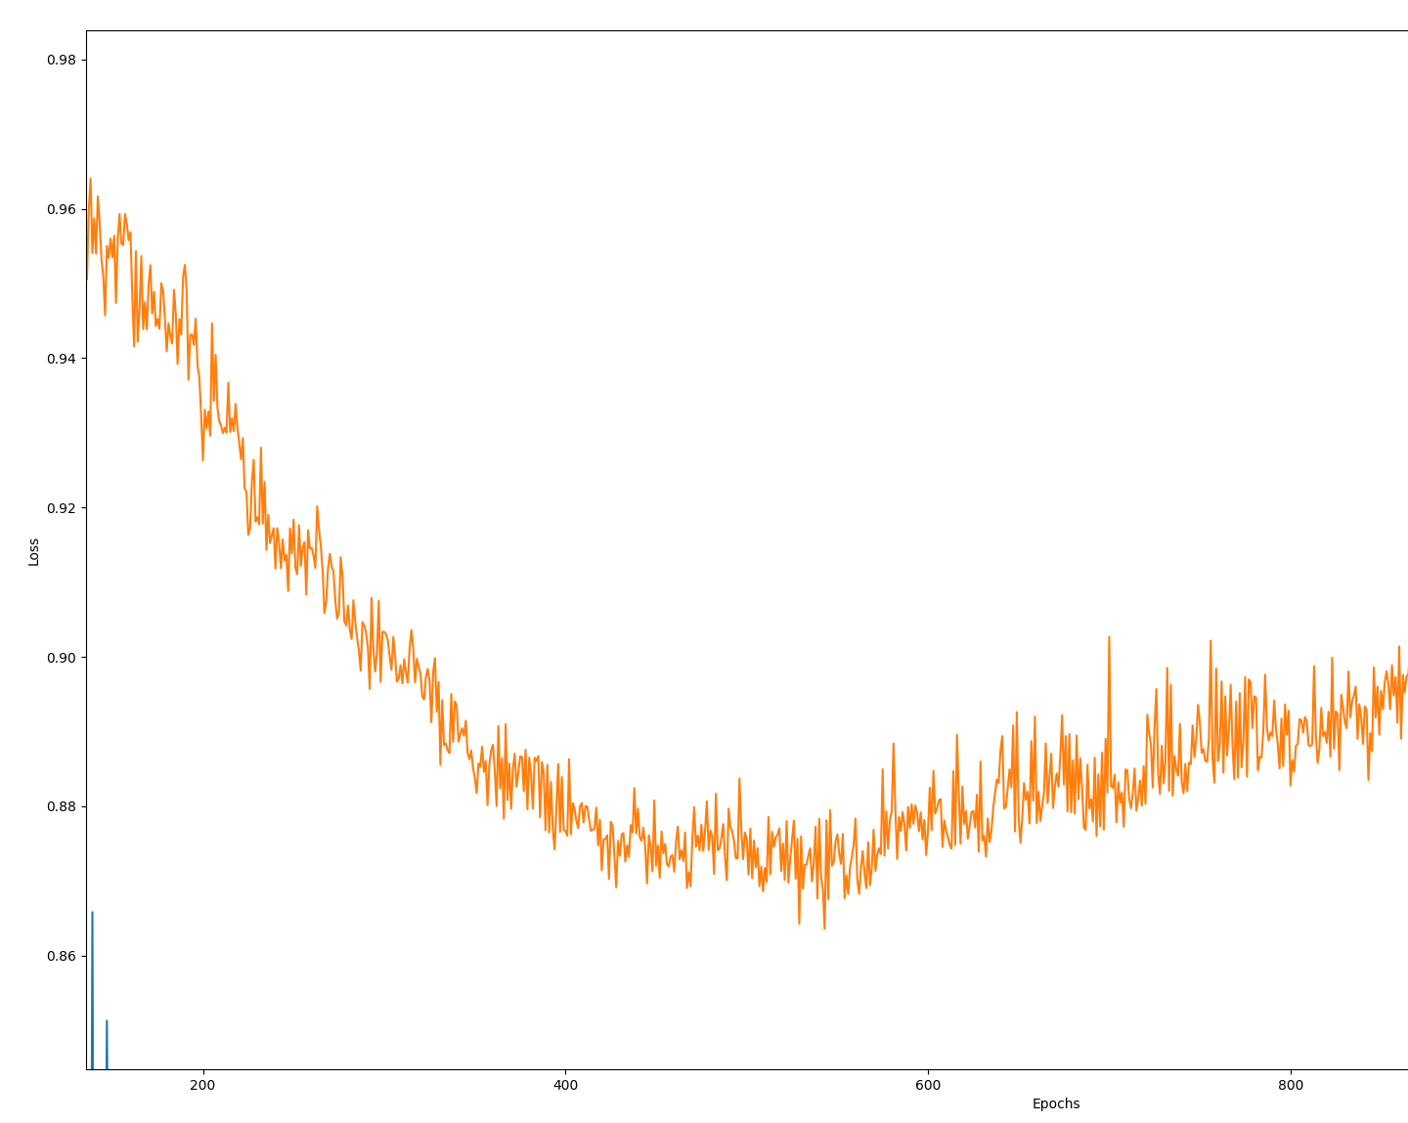
4. Validation
0.83
Fig. 10. ML Model Loss
Fig. 11. Field testing with 88% Accuracy*
*:The 88% of accuracy is based on the previous data, and the lab test of this water sample is on going.

Slide 13


5. Conclusion
Advantage
Strong expansibility and low cost
Innovation
Inorganic sensors for E.coli detection
Challenge
Device stability and data accuracy
Notes:
🎯 1. Project Achievements
✅ We have built a fully functional end-to-end system for real-time E.coli monitoring using low-cost IoT sensors and AI models.
Integrated inorganic sensor data with AI-powered analysis
Developed a complete pipeline from data collection → preprocessing → modeling → visualization
Validated model accuracy in lab settings
Delivered live demo-ready platform with automated processing and results display
🔧 2. Current Limitations
⚠️ Real-world deployment is currently limited by infrastructure and scale.
The system currently relies on a single monitoring node; real deployment would require multiple fixed stations along rivers.
Sensor calibration and long-term stability still require field validation
Data standardization across regions needs to be solved for broader compatibility
🚀 3. Future Outlook
🌍 The system is scalable, customizable, and ready for next steps.
Easily adaptable to detect other pollutants (e.g., algae, aromatic hydrocarbons) by retraining the AI model
Potential for integration into city-level water safety platforms
Currently preparing for research paper submission to disseminate our approach
Could serve as a cost-effective alternative to traditional organic detection methods

Slide 14
Thank you!

Slide 15
Reference
[1] M. Allen, “Findings of high Thames E.coli levels discovered, as new guidance issued to rowers,” River Action UK, Mar. 27, 2024. https://riveractionuk.com/findings-of-high-thames-e-coli-levels-discovered-as-new-guidance-issued-to-rowers/
[2] “Water Quality Results,” Thames21. https://www.thames21.org.uk/water-quality-results/
[3] “‘Alarmingly high’ levels of E.coli in River Thames found days before Oxbridge Boat Race,” Sky News. https://news.sky.com/story/alarmingly-high-levels-of-e-coli-in-river-thames-found-days-before-oxbridge-boat-race-13102682
[1] M. Allen, “Findings of high Thames E.coli levels discovered, as new guidance issued to rowers,” River Action UK, Mar. 27, 2024. https://riveractionuk.com/findings-of-high-thames-e-coli-levels-discovered-as-new-guidance-issued-to-rowers/
[2] “Water Quality Results,” Thames21. https://www.thames21.org.uk/water-quality-results/
[3] “‘Alarmingly high’ levels of E.coli in River Thames found days before Oxbridge Boat Race,” Sky News. https://news.sky.com/story/alarmingly-high-levels-of-e-coli-in-river-thames-found-days-before-oxbridge-boat-race-13102682
Project Link:
https://github.com/Headmaster218/Thames-pollution-detect-IoT

